Slide 1
Create a contact list application using ReactJS.
Requirements:
Must make use of ReactJS’ component reusability .
Must show the proper encapsulation of component functionalities and data through Smart/Dumb (Container/Component) design.
Hint: Use a separate component for list and create. Its probably going to be a smart component.
Must show proper usage of ReactJS’ State Management. (component state, hooks, redux)
Must show usage of Routing. (You can use react-router-dom)
Should make use of atleast 3 pages.
Must show usage of HTTP CRUD (create, retrieve, update, delete) operations.
https://jsonplaceholder.typicode.com/users will contain initial data.
Use either Firebase or json-server for backend
Minimum data to show in the table (id, name, email, contact # )

Slide 2
Browser
www.example.com
Name
Text input
Email
Text input
Contact
Text input
Add / Update
Id | Name | Email | Contact
1 | Maria Anders | maria@test.com | 030-0074321
2 | Antonio Moreno | Antonio@gmail.com | (5) 555-3932
3 | Thomas Hardy | thomas.@yahoo.com | (171) 555-7788
4 | Christina Berglund | christina@email.com | 0921-12 34 65
View Update Delete
View Update Delete
View Update Delete
View Update Delete

Slide 3
Browser
www.example.com
ID: 1
Name: Maria Anders
Email: Maria@test.com
Contact: 030-0074321
Back

Slide 4
Browser
www.example.com
Page not Found!

Slide 5
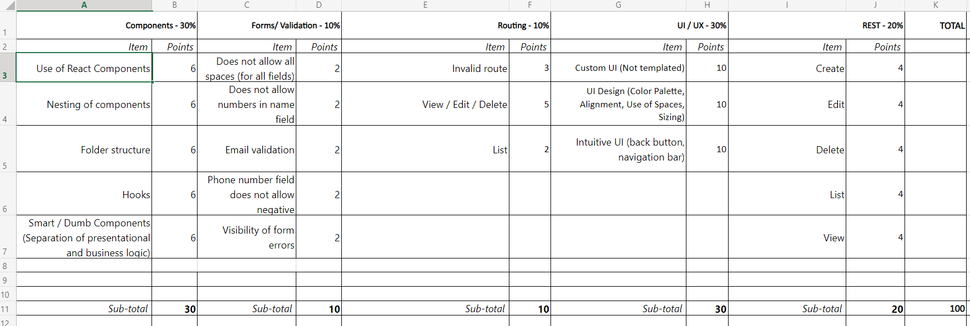
Criteria for Scoring React App

Slide 6
Submission
Through EMAIL:
ZIP project folder excluding node_modules, put it in your sharepoint/onedrive and give us access for the folder, and send it to michale.emil.rivera, keisha.l.berondo, dave.spencer.bacay, m.a.mendoza, danilo.matias through email. Subject of email should be ReactJS Assessment – {Deadline} – {eid}

